Slide 1
Server-Side APIs
Module 06

Slide 2



The Big Picture
Phase 2
Node
OOP
Express
MySQL
MVC
Full Stack Apps
Phase 1
HTML & CSS
Bootstrap
JavaScript
Web APIs
Third Party APIs
Server-Side APIs
Phase 3
NoSQL
PWAs
React
React State
MERN Apps
Comp Sci
Notes:
Take a moment to have your class pause and reflect on where they are in the course as a whole. We are nearing the end of Phase 1, where they’ve learned many different foundational topics.

Slide 3

Boot Camp Pointers
Before we get into this content, remember that you have a lot of different support systems available to you:
Learning Assistants
Office Hours
Tutoring Services
Notes:
Students are routinely challenged during class and homework assignments. Remind them that they’re not alone through the grind! Ask them to rely on their support systems more readily as they start reaching the second phase of the program.

Slide 4
This Week: Server-Side APIs
By the end of this week, you will learn how to:
Explain the difference between a client-side API and a server-side API
Explain the client-server model and request-response pattern
Explain and implement the differences between HTTP GET requests using XMLHTTPRequest, jQuery AJAX, and the fetch API
Explain HTTP response codes and handle response metadata with fetch API
Parse JSON to dynamically generate HTML
Explain the benefits and challenges of working with asynchronous JavaScript
Explain and implement query string parameters
Notes:
Walk through the learning objectives for the week with your class. These are the things they should expect to know by the end of the unit.

Slide 5
How will you use this week’s content in your next assignment?
Notes:
Use the assignment description from the unit overview to talk through the different requirements and how they align with the concepts learned throughout the module.

Slide 6
How will you use this week’s content in your career?
Notes:
Use this slide to speak to you students will use the unit’s content in their careers going forward. It will help provide much-needed context. For many developers, server-side APIs are an integral piece of their day-to-day functions. Take a moment to talk about how you may have used them at work.
Remember that students will also be using dynamically created HTML and CSS in their homework assignment this week, so you can feel free to talk about that as well.

Slide 7
Tips for Success: Server-Side APIs
Keep these tips in mind:
01
Each API’s documentation is going to be different. Read it carefully!
02
Don’t forget to be mindful of your error messages. They may help you uncover an unexpected bug.
03
Googling error messages can lead you to what other developers have done to resolve issues!

Slide 8
Where do web applications live?

Slide 9



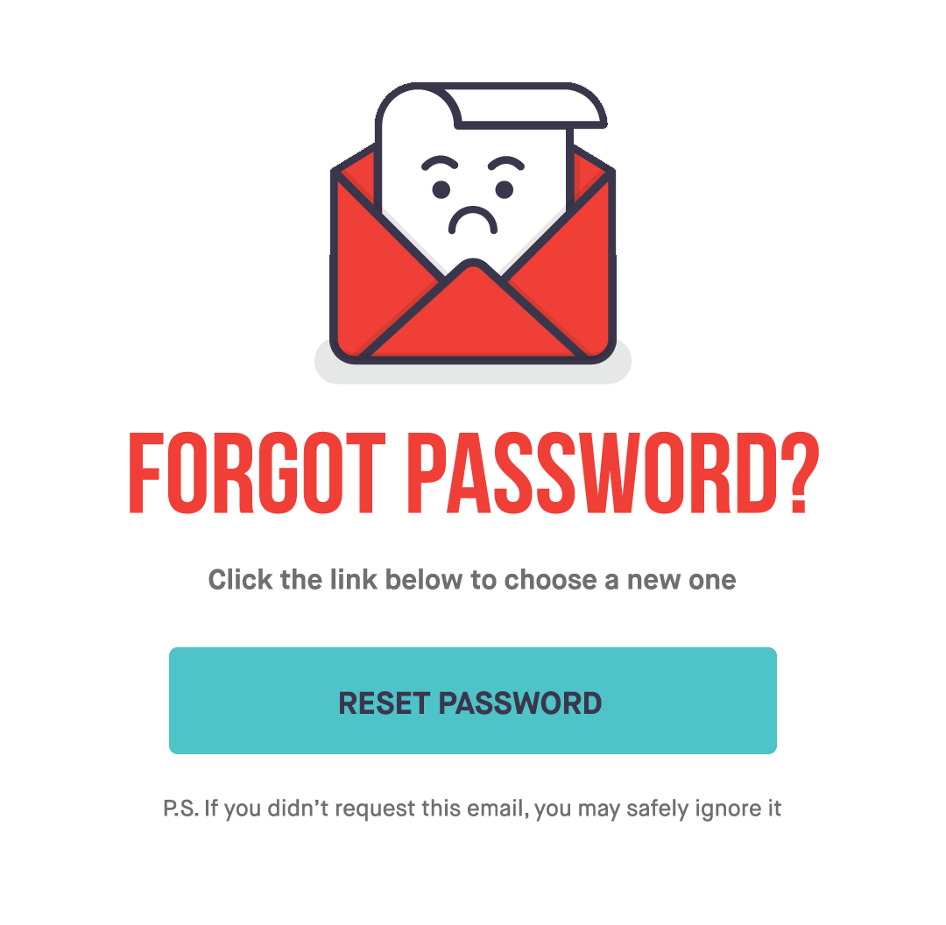
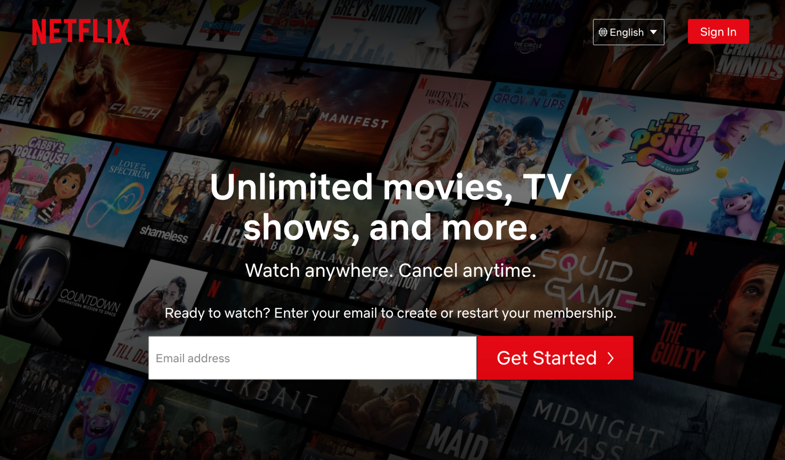

Web Applications Live on Servers
Web servers are typically nothing more than specialized computers running software with the specific task of waiting for an internet request to come in and ask for data in return.
https://www.netflix.com/
Request
Request
Response
Response
Client 12.34.56.78
Domain Name Server
76.11.48.29
Netflix Server
41.65.88.90

Slide 10
How are these requests made?

Slide 11
On the web, data is transferred over HTTP, or Hypertext Transfer Protocol. HTTP is a set of rules and regulations for how data can be requested by a client and how a server can respond to that request.

Slide 12
Across all internet-connected devices, we constantly make HTTP requests to web servers for different types of data constantly, like the following examples.

Slide 13
Requesting Data Over HTTP
Across all internet-connected devices, we constantly make HTTP requests to web servers for different types of data constantly, like the following:
Visiting deployed applications at <username>.github.io.
A phone or watch automatically updating the weather forecast.
Using a media streaming service.
Using HTML <link> and <script> tags to incorporate Bootstrap, jQuery, or any other third-party API into an application.

Slide 14
Can we use data from other servers in an application?

Slide 15
Yes, we can! Just as we’ve used third-party APIs to make an application’s functionality and design easier to maintain, we can use specific functionality to request data over HTTP and use that data in an application.

Slide 16
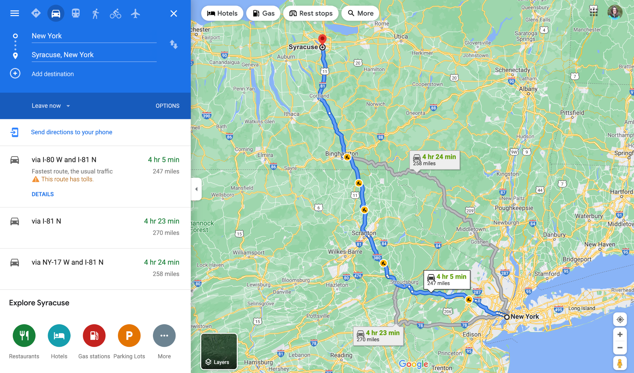

JSON (JavaScript Object Notation)
This data usually comes in the form of a special type of JavaScript object known as JSON (JavaScript Object Notation).
https://www.google.com/maps
Get Request
JSON Response
Client 12.34.56.78
Google Server
10.23.97.54

Slide 17
JSON (JavaScript Object Notation)
With this data, we can do any of the following in an application:
Retrieve weather data to display in an application.
Use Google Maps to help create a trip itinerary.
Manage Spotify or YouTube playlists.
Control lights, alarms, and other devices.
And much, much more!

Slide 18
How can we learn to use and
implement these types of APIs?

Slide 19


How to Learn Server-Side APIs
Like other APIs we’ve used in the past, the implementation of server-side APIs depends on what solution that API provides. Some are very simple, while others are complex and powerful, so it’s up to us to determine which parts to use.
Baseball
Results:
1102 books on baseball

Slide 20
How to Learn Server-Side APIs
You can try the following strategies to learn more about specific APIs:
Read the official documentation and practice with the provided examples.
Reverse-engineer finished code to see how something was accomplished.
Build something from scratch and debug it using the Chrome DevTools.
Ask questions!

Slide 21
Mini Project

